Slide 1

AI6102: Machine Learning Methodologies & Applications
Team Project Instructions

Slide 2
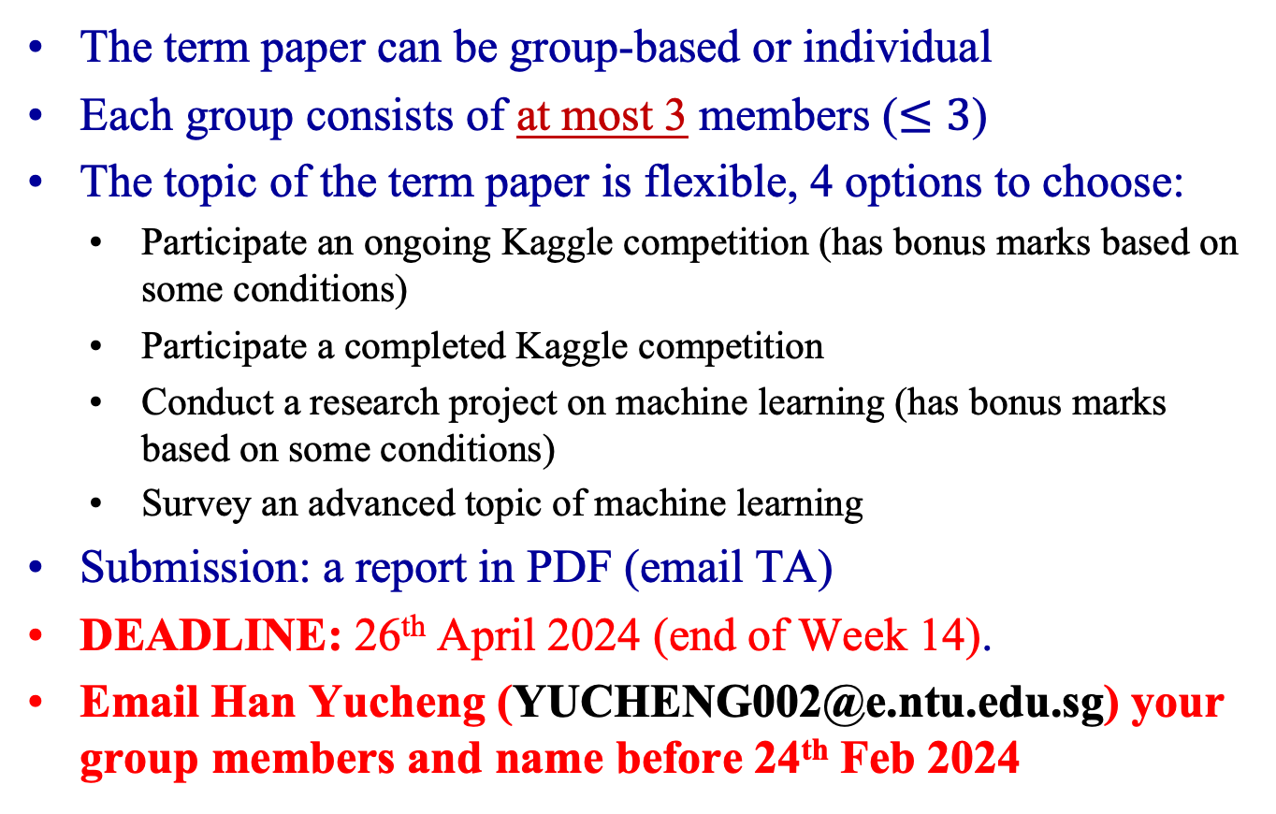
General Information
The term paper can be group-based or individual
Each group consists of at most 3 members ($≤3$)
The topic of the term paper is flexible, 4 options to choose:
Participate an ongoing Kaggle competition (has bonus marks based on some conditions)
Participate a completed Kaggle competition
Conduct a research project on machine learning (has bonus marks based on some conditions)
Survey an advanced topic of machine learning
Submission: a report in PDF (email TA)
DEADLINE: 26th April 2024 (end of Week 14).
Email Han Yucheng (YUCHENG002@e.ntu.edu.sg) your group members and name before 24th Feb 2024

Slide 3
Brief Description
Ongoing Kaggle Competition
Any ongoing Kaggle Competition
Completed Kaggle Competition
Pick one from the candidate list on the next slide
Research Project
Any research project related to machine learning: either fundamental research (ML methods) or application
Research Survey
Conduct a comprehensive survey on an advanced topic of machine learning

Slide 4
Kaggle Competition Candidates (Completed)
Zillow Prize: Zillow’s Home Value Prediction (Zestimate) url: https://www.kaggle.com/c/zillow-prize-1
Sberbank Russian Housing Market url: https://www.kaggle.com/c/sberbank-russian-housing-market/
Google Smartphone Decimeter Challenge 2022 url: https://www.kaggle.com/competitions/smartphone-decimeter-2022
Store Item Demand Forecasting Challenge url: https://www.kaggle.com/c/demand-forecasting-kernels-only/
Nomad2018 Predicting Transparent Conductors url: https://www.kaggle.com/c/nomad2018-predict-transparent-conductors/
HuBMAP - Hacking the Kidney url: https://www.kaggle.com/competitions/hubmap-kidney-segmentation
PetFinder.my - Pawpularity Contest url: https://www.kaggle.com/competitions/petfinder-pawpularity-score
Elo Merchant Category Recommendation url: https://www.kaggle.com/c/elo-merchant-category-recommendation/
Northeastern SMILE Lab - Recognizing Faces in the Wild https://www.kaggle.com/c/recognizing-faces-in-the-wild/

Slide 5
Report – Kaggle Competition including both completed & ongoing
Recommended content (NeurIPS/CVPR/ICML latex template)
Problem statement of the task in your own words
Challenges of the problem
Your proposed solution
Motivation (feature engineering, ML methods, etc)
Detailed steps with explanations
Experiment
Conduct experiments to verify your motivations
Conduct experiments to show the performance of your proposed solution (both cross-validation results and the screenshot of leaderboard results)
Conclusion
What you have learned from the competition

Slide 6
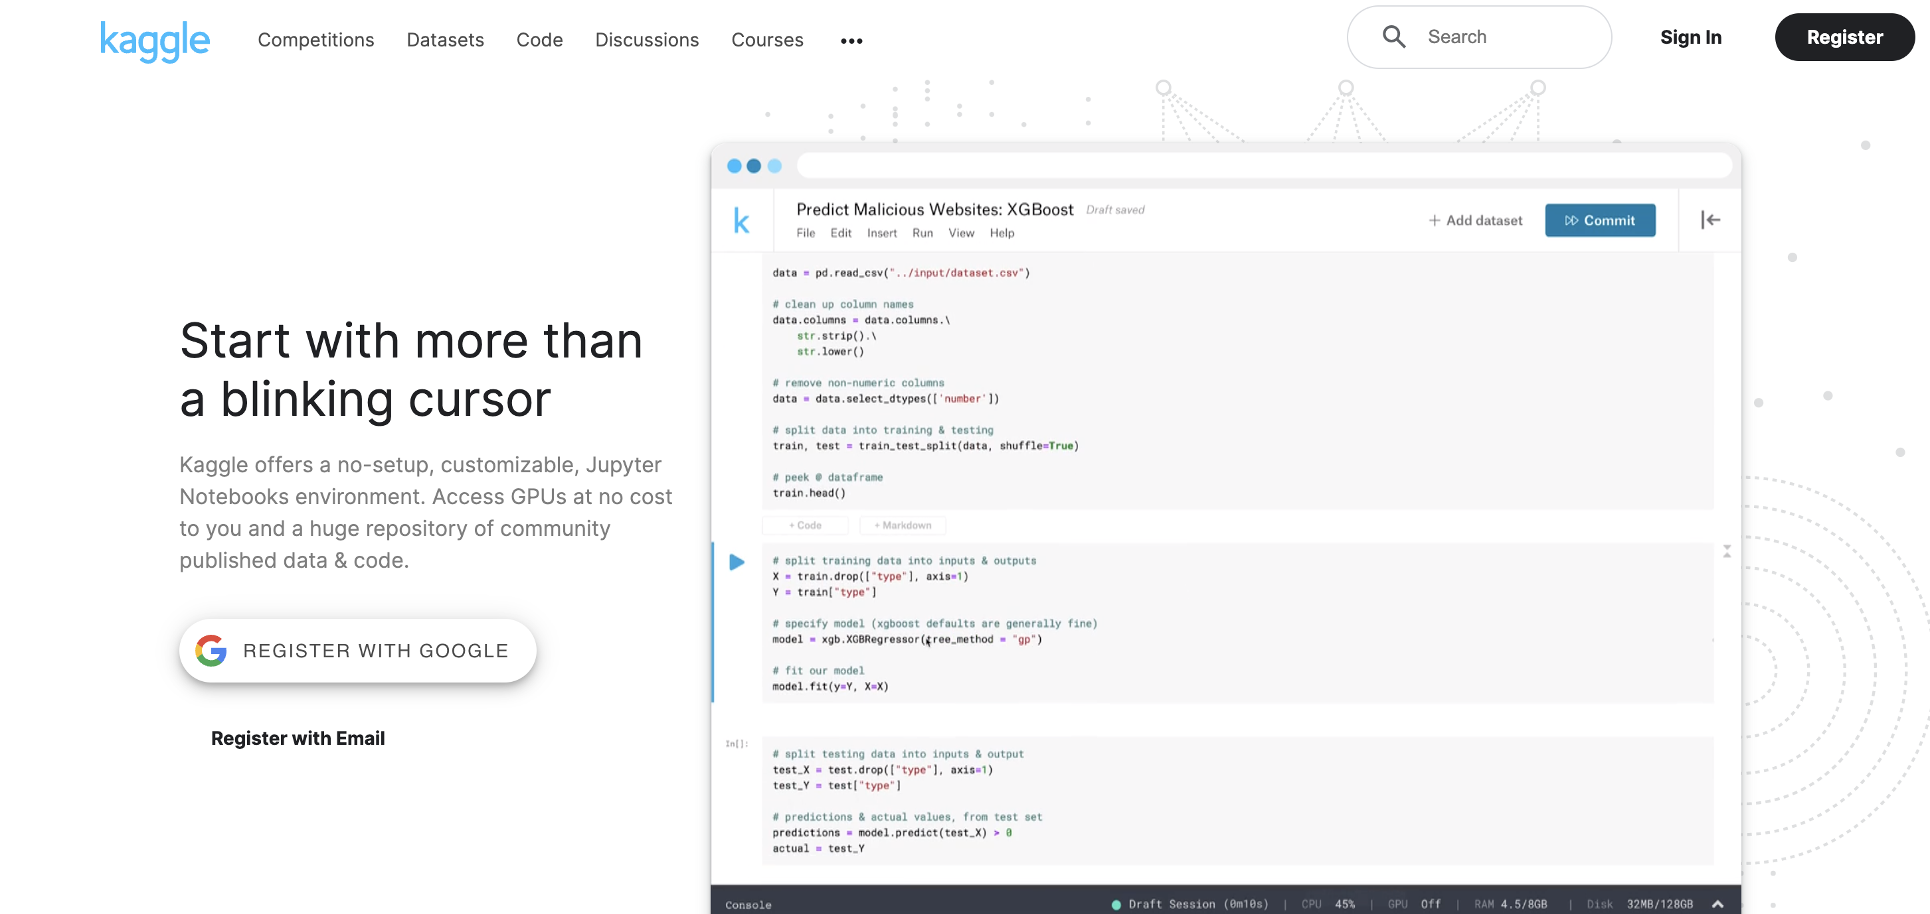

Slide 7
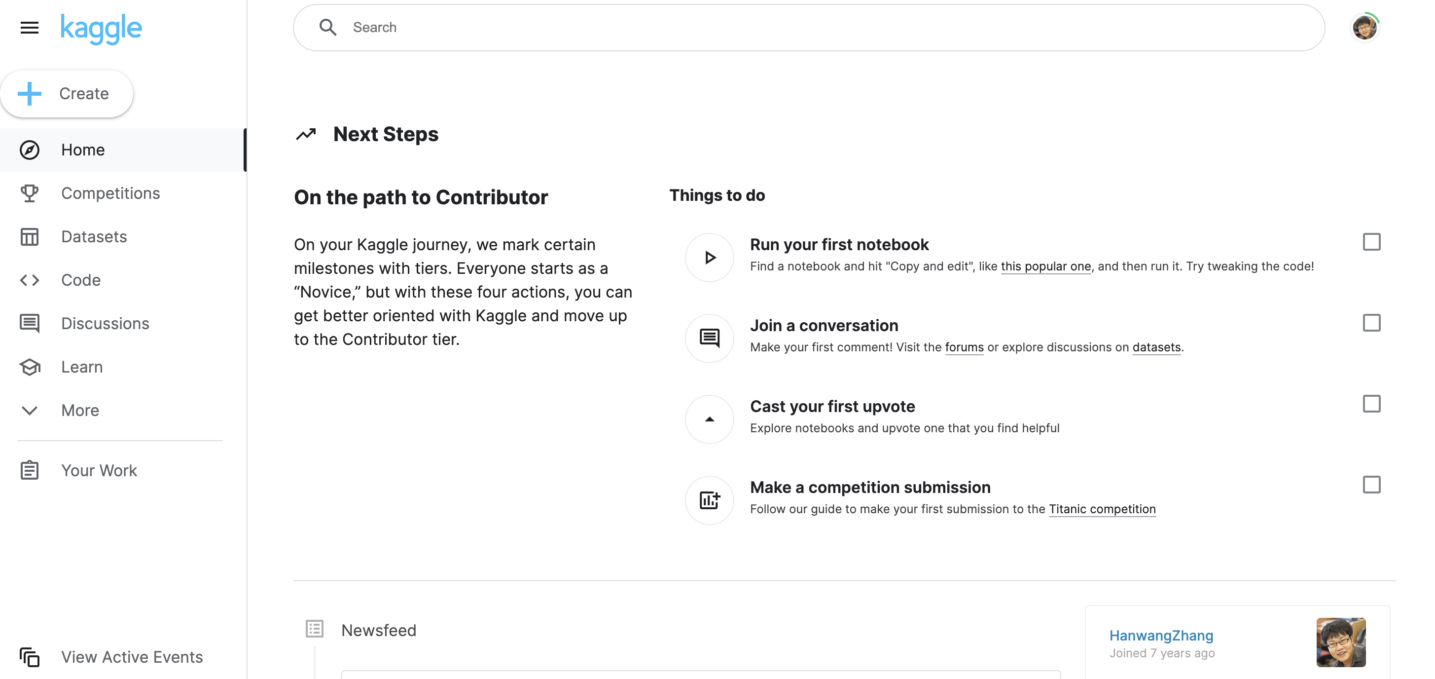

Slide 8
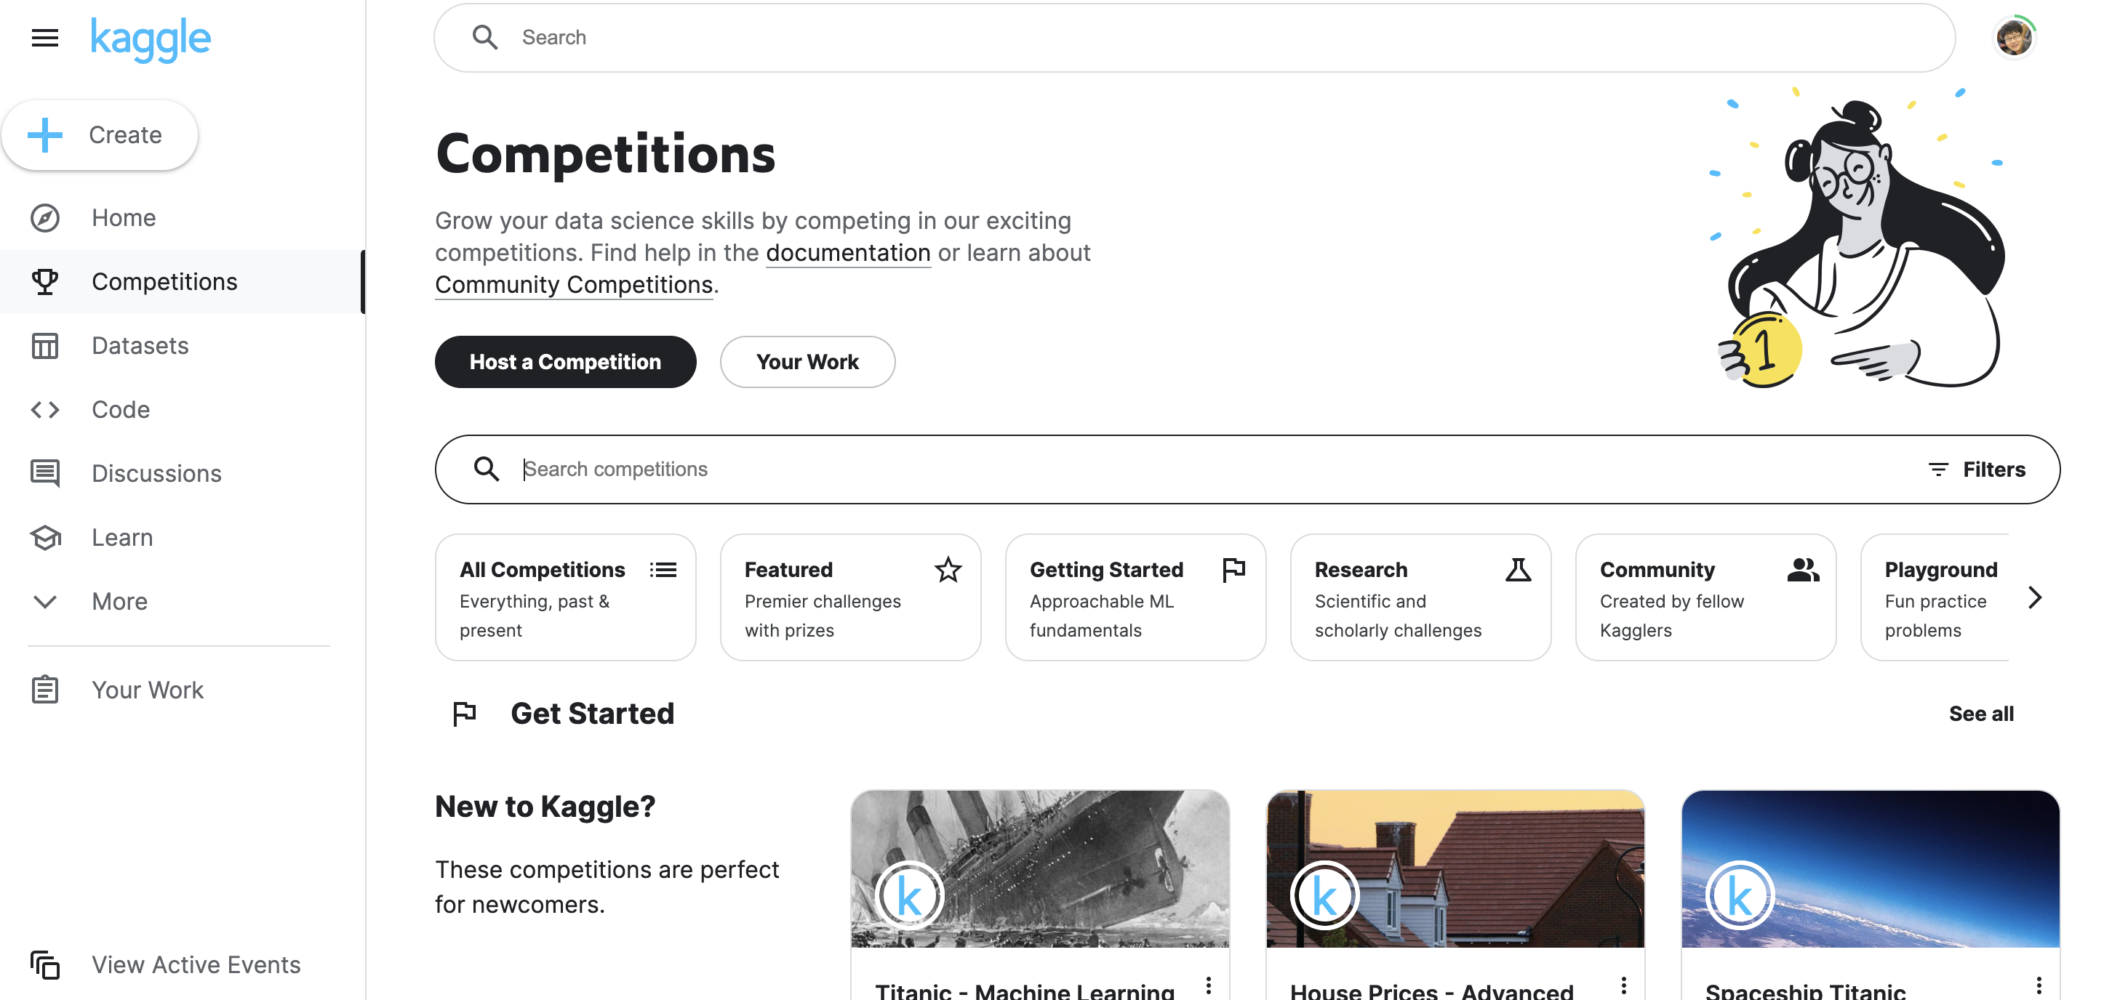

Slide 9
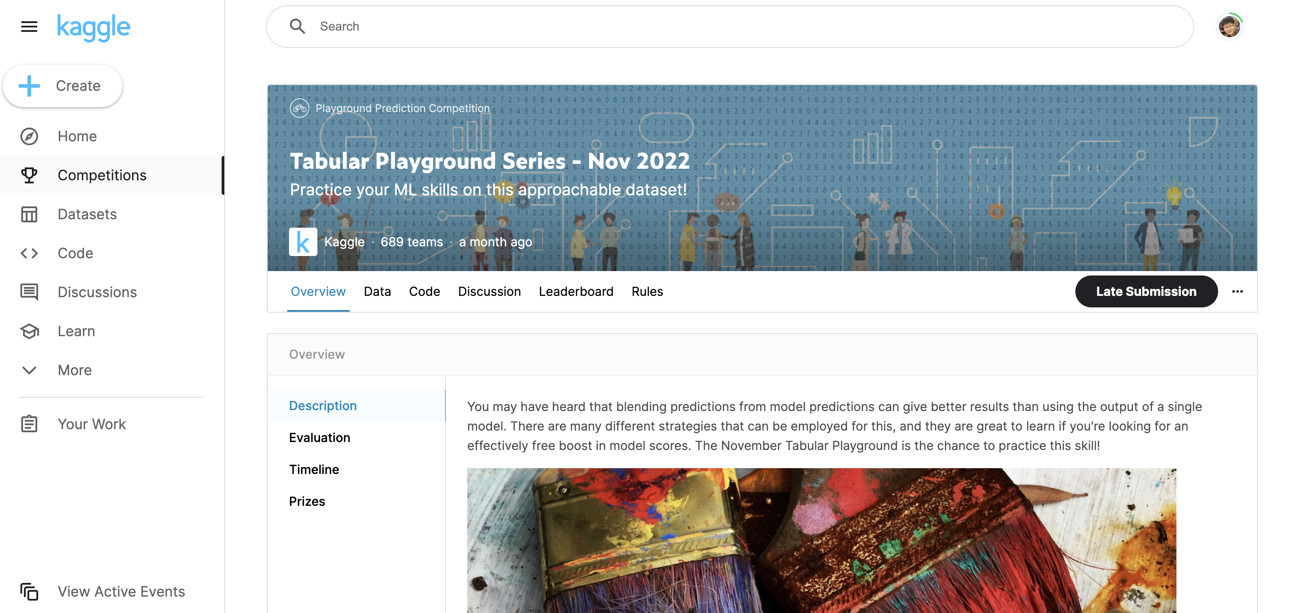

Slide 10
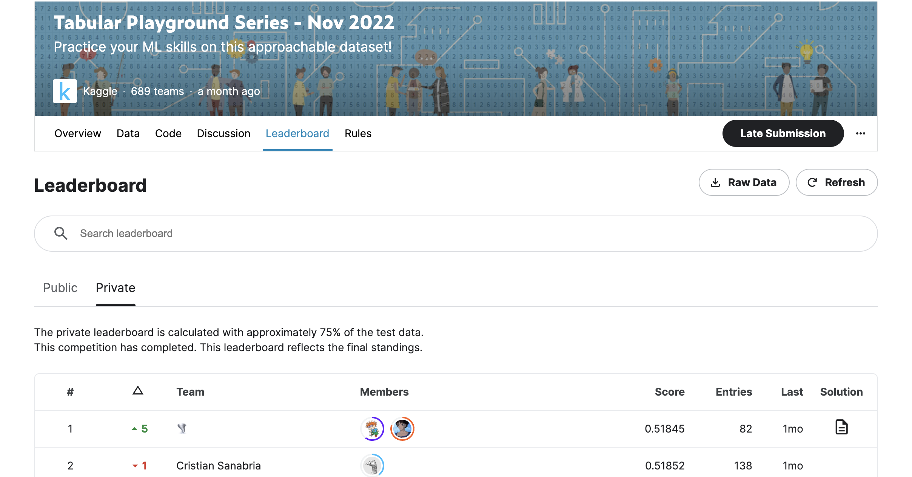

Slide 11
Report – Research Paper
Recommended content
Problem statement of the research topic
Related work – limitations of existing methods
Your proposed method
Motivation
Detailed steps with explanations
Experiment
Conduct experiments to verify your motivations
Conduct comparison experiments with SOTA methods
Conclusion
Limitation of your proposed method, future work

Slide 12
Report – Research Survey
Recommended content
Problem statement of the research topic
Categorize existing methods based on your own insights
Describe some representatives in each category
Motivation, high-level idea, detailed methodology
Experiment
Conduct comparison experiments between SOTA methods
Analyze advantages and disadvantages of SOTA methods
Conclusion
Potential new directions of the topic

Slide 13
Assessment
Writing
Whether the organization is logically clear
Whether the descriptions on the proposed solution / proposed method / existing SOTA methods are clear
Whether there are many typos
Experiments
Whether the experiments are extensive to verify the proposed solution / proposed method or to analyze the disadvantages or advantages between SOTA methods
Bonus (+20%)
For ongoing Kaggle competition, if the ranking in leaderboard is top 10%
For research paper: if a novel idea is proposed compared with existing methods

Slide 14
Frequent Q&A
Regarding completed Kaggle competitions, can we choose another Kaggle competition beyond the candidate list?
No, you can only choose one from the candidate list if you decide to choose a competed Kaggle competition for your term paper
Are there requirements on the format of the report?
No hard requirements. Suggestions: Latex template, e.g., search CVPR 2024 Author Kit
Don’t forget include ALL team members NAME and Matric.
Can we use other ML techniques beyond what are taught in this module, such as deep learning models？
Yes, you can
Do we need to submit source codes?
No
Can the report submission deadline be extended?
No, it is a hard deadline

Slide 15
Thank you!

